Slide 1
SKYTRAX AIRLINE REVIEW ANALYSIS
16th December of 2022

Slide 2
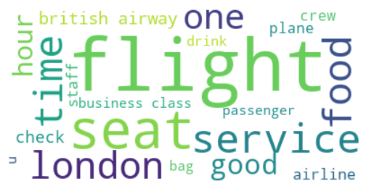
Results
Key topics
Sentiment
Out of 1000 reviews, 533 were positive, 450 were negative and 17 were neutral. Majority of reviews were polarised as either positive or negative.
The word cloud chart shows that the key topics within the reviews include “flight”, “service”, “seat”, “food”, “time” showing that the customers are talking about their experience.
53%
45%
2%

